Slide 1
Further Resources
Other Places to Talk About, Practice, and Learn Chef

Slide 2
Going Forward
There are many Chef resources available to you outside this class. During this module we will talk about just a few of those resources. But…remember what we said at the beginning of this class:
The best way to learn Chef is to use Chef

Slide 3
Practice Chef
First, let’s talk about stuff you can read to help you learn Chef.

Slide 4
learnchef.com
Interactive learning for those new to Chef.
Notes:
Another great place to practice Chef is our awesome Learn Chef site. These interactive modules provide you with an opportunity to run through exercises similar to those we did in this class, and it is updated when new Chef features are introduced. This is one of the most robust self-guided tutorial sites out there.

Slide 5
Resources You Can Read
A lot of people in the Chef community have written about Chef.
Here are just a few of those resources.

Slide 6
docs.chef.io
Docs are available to you, 24 hours a day, 7 days a week.
Any question you have, you probably will find the answer for on our Docs site.
Notes:
Remember, how often we referred to the Docs site throughout this workshop. That wasn’t by accident. We wanted you to become comfortable with using our Docs site to resolve issues and learn about the many Chef tools out there.
Docs are there, available to you, 24 hours a day, 7 days a week. Any question you have, you probably will find the answer on our Docs site.

Slide 7
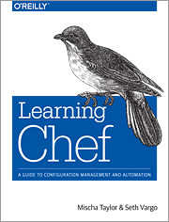
Learning Chef
A Guide to Configuration Management and Automation
Notes:
Some people who have used Chef for years have written some excellent books about Chef. Check out Mischa Taylor’s and Seth Vargo’s Guide to Configuration Management and Automation. You can find it on O’Reilly. It’s a great book.

Slide 8
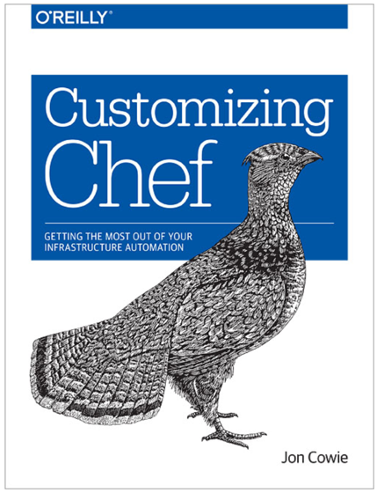
Customizing Chef
Getting the Most Out of Your Infrastructure Automation
Notes:
Additionally, you may want to read Jon Cowie’s Getting the Most Out of Your Infrastructure Automation. It’s also available on O’Reilly.

Slide 9
YouTube Channel
ChefConf Talks
Training Videos
https://www.youtube.com/user/getchef/playlists
Notes:
We have uploaded a number of videos to the Chef YouTube channel, including training videos and talks from past Chef conferences.

Slide 10

theshipshow.com
Notes:
The Ship Show is a twice-monthly podcast, featuring discussion on everything from build engineering to DevOps to release management, plus interviews, new tools and techniques, and reviews.

Slide 11

foodfightshow.org
Notes:
Food Fight is a bi-weekly podcast for the Chef community. We bring together the smartest people in the Chef community and the broader DevOps world to discuss the thorniest issues in system administration.

Slide 12
Chef Developers' IRC Meeting
https://github.com/chef/chef-community-irc-meetings
Notes:
Join members of the Chef Community in a weekly meeting for Chef Developers where we’ll discuss the future of the Chef project and other things pertinent to the community. The agenda and schedule can be found at this link.

Slide 13

https://www.chef.io/chefconf/
Notes:
ChefConf is a gathering of hundreds of Chef community members. We get together to learn about the latest and greatest in the industry (both the hows and the whys), as well as exchange ideas, brainstorm solutions, and give hugs, which has become the calling card of the DevOps community, and the Chef community in particular. ChefConf 2016 will be held in Austin, Texas during July.

Slide 14

Chef Community Summit
https://www.chef.io/summit/
Notes:
The Chef Community will gather for two days of open space sessions and brainstorm on Chef best practices.
The Chef Community Summit is a facilitated Open Space event. The participants of the summit propose topics, organize an agenda, and discuss and work on the ideas that are most important to the community.
The 2015 summit takes place in two locations–Seattle on October 14 & 15, then in London on November 3 and 4. Dates for the 2016 Summit will be announced in the spring of 2016.

Slide 15

Thank You!

